Slide 1
Topic 3: Integrated gate circuit and flip-flop
Switching characteristics of semiconductor devices, TTL gate, CMOS gate.
Flip-flop

Slide 2
Flip-Flops
Controlled latches are level-triggered
Flip-Flops are edge-triggered
C
CLK
Positive Edge
CLK
Negative Edge

Slide 3
Flip-flop
A flip-flop is a bistable (two stable states) logic circuit that can store only one bit at a time, either a 1 or a 0.
The output of a flip-flop indicates which bit it is storing.
An edge-triggered flip-flop changes state either at the positive edge (rising edge) or at the negative edge (falling edge) of the clock pulse and is sensitive to its inputs only at this transition of the clock.

Slide 4
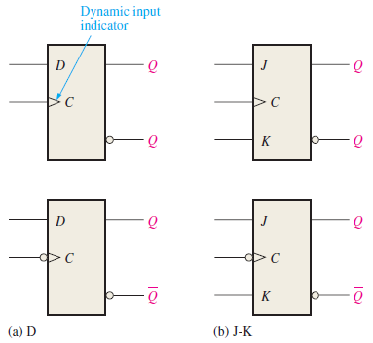
Positive and Negative Edge Triggered
Two types of flip-flops
D flip-flop
JK flip-flop
The top two flip-flops are positive edge triggered (no bubble at C input).
The bottom two flip-flops are the negative edge-triggered (with bubble at the C input).

Slide 5
D flip-flop
When D is HIGH, the Q output goes HIGH on the triggering edge of the clock pulse, and the flip-flop is SET.
When D is LOW, the output goes LOW on the triggering edge of the clock pulse, and the flip-flop is RESET.
IMPORTANT: The flip-flop cannot change state except on the triggering edge of a clock pulse.

Slide 6
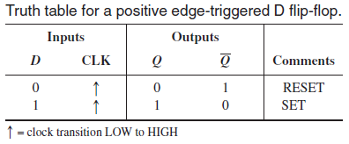
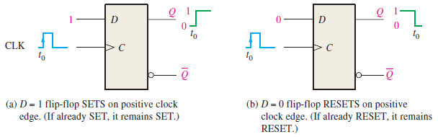
Truth Table of D flip-flop
The operation of a negative edge-triggered D flip-flop are the same as those of the positive edge-triggered device except that the falling edge of the clock pulse is the triggering edge.

Slide 7
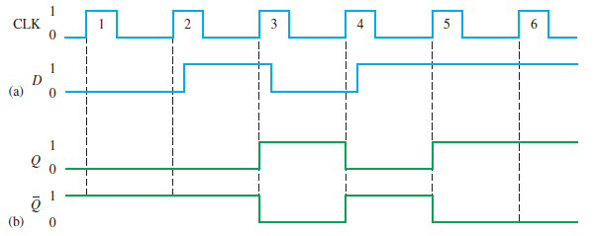
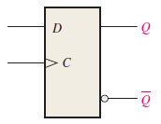
Example of D flip-flop operation using a timing diagram
Note: Any changes in the output Q only happen at the positive edge of the input clock CLK.
Once the output Q is determined, the other output Q’ is simply the complement of Q.

Slide 8
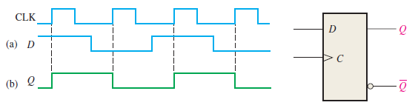
More example of D flip-flop timing diagram
Given the waveform for the D input and the clock, determine the output waveform if the flip-flop starts out RESET.
SET
RESET
SET
RESET

Slide 9
JK flip-flop
When J is HIGH and K is LOW, the Q output goes HIGH on the triggering edge of the clock pulse, and the flip-flop is SET.
When J is LOW and K is HIGH, the Q output goes LOW on the triggering edge of the clock pulse, and the flip-flop is RESET.
When both J and K are LOW, the output does not change from its prior state. It is in STORE operation.
When both J and K are HIGH, the flip-flop changes state. This is called TOGGLE mode.

Slide 10
JK flip-flop
J
S
Q
CLK
RS F/F
K
R
Q
⇓
J
Q
CLK
JKFF
K
Q

Slide 11
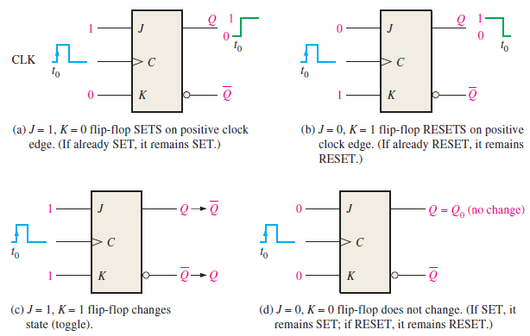
Operations of JK flip-flop

Slide 12
Flip-Flop Characteristic Equations
Analysis / Derivation
J | K | Q(t) | Q(t+1)
0 | 0 | 0 | 0
0 | 0 | 1 | 1
0 | 1 | 0 | 0
0 | 1 | 1 | 0
1 | 0 | 0 | 1
1 | 0 | 1 | 1
1 | 1 | 0 | 1
1 | 1 | 1 | 0
J
Q
 |  |  |  | K
 |  | 0 | 1 | 0 | 0
J |  | 1 | 1 | 0 | 1
 |  |  | Q
K
Q
Q(t+1) = JQ’ + K’Q

Slide 13
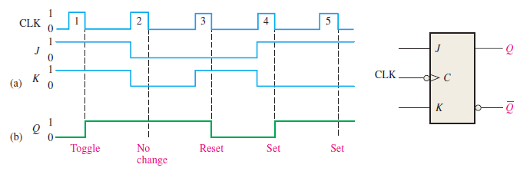
Example of JK flip-flop operation using a timing diagram
REMEMBER: The flip-flop cannot change state except on the triggering edge of a clock pulse.

Slide 14
T flip-flop
The T flip-flop or Toggle flip-flop changes output state at every active clock edge if the input T = 1.
If T = 0, the output stays the same.
T flip-flops are often used as counters.

Slide 15
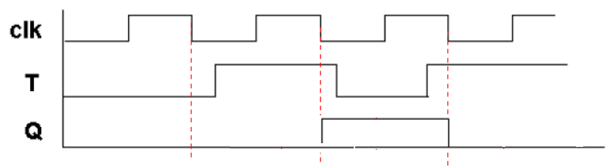
Example of negative edge-triggered T flip-flop
An example of a negative edge-triggered T flip-flop is shown below.
Note that the output Q toggles (change to the complement of the current output) at every falling edge (negative edge) of the clock clk, when input T = 1.
TOGGLE
TOGGLE

Slide 16
T flip-flop from JK flip-flop and D flip-flop
T flip-flop can be built from JK flip-flop or D flip-flop as shown below.
Constructing a T flip-flop using a JK flip-flop
Constructing a T flip-flop using a D flip-flop

Slide 17
Flip-flop with asynchronous inputs
The D flip-flop and JK flip-flop discussed previously are called synchronous inputs because data on these inputs are transferred to the flip-flop’s output only on the triggering edge of the clock pulse. Hence, data are transferred synchronously with the clock.
Flip-flops can have asynchronous inputs. These are inputs that affect the state of the flip-flop independent of the clock.
They are normally labelled preset (PRE) and clear (CLR).

Slide 18
D flip-flop with asynchronous PRESET and CLEAR inputs
A D flip-flop with asynchronous PRESET and CLEAR inputs are shown below.
These inputs are active LOW (indicated by bubbles).
These inputs must be kept HIGH for synchronous operation.

Slide 19
Timing Diagram of D flip-flop with PRESET and CLEAR inputs
When active-LOW PRESET = 0, the output of D flip-flop is SET (Q=1).
When active-LOW CLEAR = 0, the output of D flip-flop is RESET or CLEAR (Q=0).
When active-LOW CLEAR and PRESET are both HIGH, normal synchronous operation of D flip-flop takes place.

Slide 20
Flip-Flop Characteristic Equations
D
Q
D | Q(t+1)
0 | 0
1 | 1
Q(t+1) = D
Q
J | K | Q(t+1)
0 | 0 | Q(t)
0 | 1 | 0
1 | 0 | 1
1 | 1 | Q’(t)
J
Q
Q(t+1) = JQ’ + K’Q
K
Q
T
Q
T | Q(t+1)
0 | Q(t)
1 | Q’(t)
Q(t+1) = T ⊕ Q
Q

Slide 21
Propagation Delay
A propagation delay time is the interval of time required after an input signal has been applied for the resulting output change to occur.
Two definitions of propagation delay times:
Propagation delay t_{PLH} as measured from the triggering edge of clock pulse to the LOW-to-HIGH transition at the output. See figure (a) in the next slide.
Propagation delay t_{PHL} as measured from the triggering edge of clock pulse to the HIGH-to-LOW transition at the output. See figure (b) in the next slide.

Slide 22
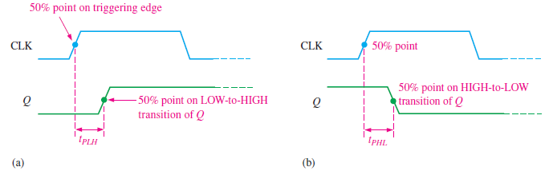
Timing diagram to illustrate the propagation delay times t_{PLH} and t_{PHL}
t_{PLH} t_{PHL}

Slide 23
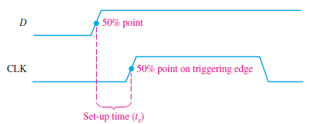
Setup Time
The setup time t_{s} is the minimum interval required for the logic levels to be maintained constantly on the inputs (J and K, or D) prior to the triggering edge of the clock pulse in order for the levels to be reliably clocked into the flip-flop.

Slide 24
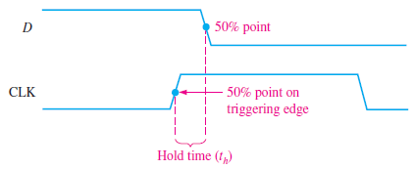
Hold Time
The hold time t_{h} is the minimum interval required for the logic levels to remain on the inputs after the triggering edge of the clock pulse in order for the levels to be reliably clocked into the flip-flop.

Slide 25
Comparison of operating parameters for four IC families of flip-flops of the same type at 25°C
 | CMOS |  | Bipolar (TTL)
Parameter | 74HC74A | 74HC74 | 74LS74A | 74F74
t_{PHL} (CLK to Q) | 17ns | 4.6ns | 40ns | 6.8ns
t_{PLH} (CLK to Q) | 17ns | 4.6ns | 25ns | 8.0ns
t_{s} (setup time) | 14ns | 5.0ns | 20ns | 2.0ns
t_{h} (hold time) | 3.0ns | 0.5ns | 5ns | 1.0ns

Slide 26
FlipFlop and Latch Applications
Bounce elimination switch
Shift Register
Counters
Frequency Division
Memory circuits etc.

Slide 27
FF Applications
SR Latch – Application as Switch Debouncer
V_{A}
V
0
A
B
V_{B}
V
0
V

Slide 28
Using NOR SR latch
A
S
R
Q
Q’
V
B

Slide 29
V
0
V_{A}
V_{B}
V
0
Q
Q’

Slide 30
FF Applications
Shift Register
A register is a group of flipflops which can store a group of bits. Lets consider a 4 FF register. Each of the four parallel data lines is connected to the D input of a flip-flop. The clock inputs of the flip-flops are connected together, so that each flip-flop is triggered by the same clock pulse. In this example, positive edge-triggered flip-flops are used, so the data on the D inputs are stored simultaneously by the flip-flops on the positive edge of the clock, as indicated in the timing diagram. Also, the asynchronous reset (R) inputs are connected to a common CLR line, which initially resets all the flip-flops.

Slide 31
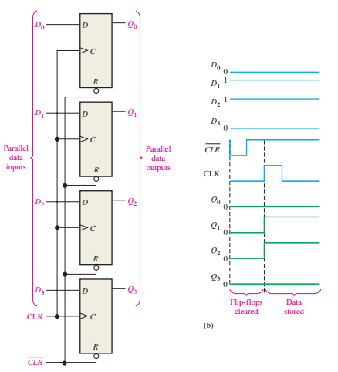

Slide 32
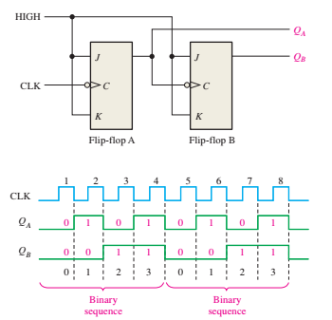
FF Applications
Counters
Counters are the sequential circuits that can count the events. Electrical pulses corresponding to the event are produced using a transducer/sensors and these pulses are counted to keep track of the no. of events.

Slide 33
FF Applications
Consider a 2-bit counter connected for asynchronous operation. Negative edge-triggered J-K flip-flops are used for illustration. Both flip-flops are initially RESET. Flip-flop A toggles on the negative-going transition of each clock pulse. The Q output of flip-flop A clocks flip-flop B, so each time QA makes a HIGH-to-LOW transition, flip-flop B toggles. The resulting QA and QB waveforms are shown in the figure.

Slide 34
FF Applications

Slide 35
Summary
Switching characteristics of TTL and CMOS
Latch
SR latch (active LOW and active HIGH)
Gated SR latch
D latch
Gated D latch
Flip-flop
D flip-flop
JK flip-flop
T flip-flop
Timing
Propagation Delay
Setup time
Hold time

